Slide 1

Prototype design pattern
Presented By:
Muhammad Huzzifa (2020CS606)
Hafiz Abdul Rehman (2020CS624)
Presented To:
Dr. Farah Adeeba

Slide 2
agenda
Introduction
Intent
Problem
Solution
UML Structure
Participants
Applicability
How to Implement?
Example

Slide 3
introduction
Prototype design pattern is one of the Creational Design pattern, so it provides a mechanism of object creation.
Prototype design pattern is used when the Object creation is a costly affair and requires a lot of time and resources and you have a similar object already existing.
Prototype pattern provides a mechanism to copy the original object to a new object and then modify it according to our needs.

Slide 4
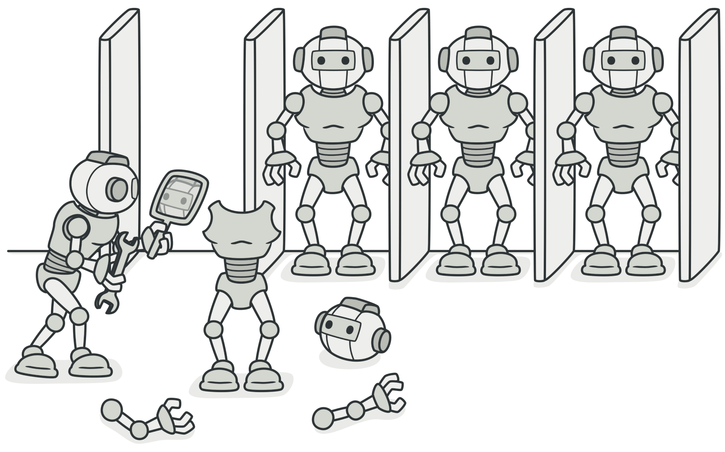
intent
To specify the kinds of objects to create using a prototypical instance, and create new objects by copying this prototype.

Slide 5

Problem
Say you have an object, and you want to create an exact copy of it. How would you do it?

Slide 6
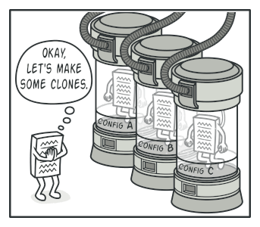
Solution
The Prototype pattern delegates the cloning process to the actual objects that are being cloned.
The pattern declares a common interface for all objects that support cloning.
This interface lets you clone an object without coupling your code to the class of that object.
Usually, such an interface contains just a single clone method.
The implementation of the clone method is very similar in all classes.

Slide 7
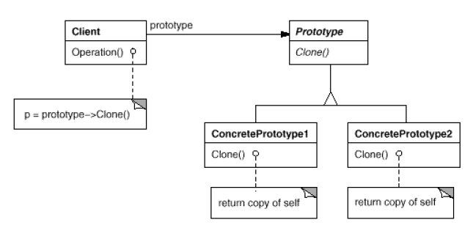
UML Structure

Slide 8
participants
Prototype:
Declare an interface for cloning itself.
ConceretePrototype:
Implements an operation for cloning itself.
Client:
Creates new object by asking a prototype to clone itself.

Slide 9
Applicability
Use the Prototype pattern when your code shouldn’t depend on the concrete classes of objects that you need to copy.
Use the pattern when you want to reduce the number of subclasses that only differ in the way they initialize their respective objects.

Slide 10
How to implement
Create the prototype interface and declare the clone method in it.
A prototype class must define the alternative constructor that accepts an object of that class as an argument. The constructor must copy the values of all fields defined in the class from the passed object into the newly created instance. If your programming language doesn’t support method overloading, you won’t be able to create a separate “prototype” constructor.
The cloning method usually consists of just one line: running a new operator with the prototypical version of the constructor.
Optionally, create a centralized prototype registry to store a catalog of frequently used prototypes.
Finally, replace the direct calls to the subclasses’ constructors with calls to the factory method of the prototype registry.

Slide 11
Example
We have created pseudocode for Vehicles. All types of vehicles such as two-wheelers, four-wheelers, tires, etc. have some basic features such as number of tyres, average, number of seats, Color and Fuel.
After creating an object of appropriate vehicle type, our client's (showroom owner or manager) end goal is to store the sold vehicles record in the database.
We Performed this scenario in java by using classes.

Slide 12
Example (Code)
In the First Step, we have made abstract vehicle class along with their functions and attributes. Our prototype or abstract class will have a constructor which will accept an object of this class as an argument. This constructor will copy all the instances from the passed object to the new one. We have also create a function that prints the details of each attribute.
Then we create concrete prototype classes of vehicle which are Bike and Car in our Scenario. Both classes implements clone function.
Then in main class (Client code) we have created a list of vehicles and vehicleCopy List for Cloning objects. Then after adding details of each concrete class we add in list.
The, we create copy of those objects in vehicleCopy List. Then, we called function toString for each class.

Slide 13
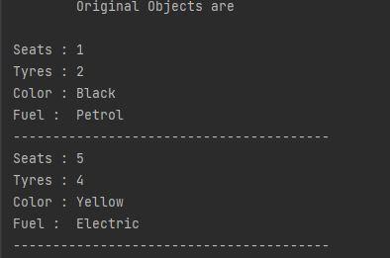
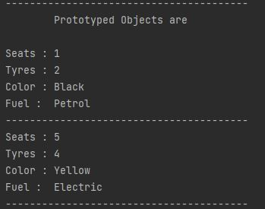
Example (Output)

Slide 14
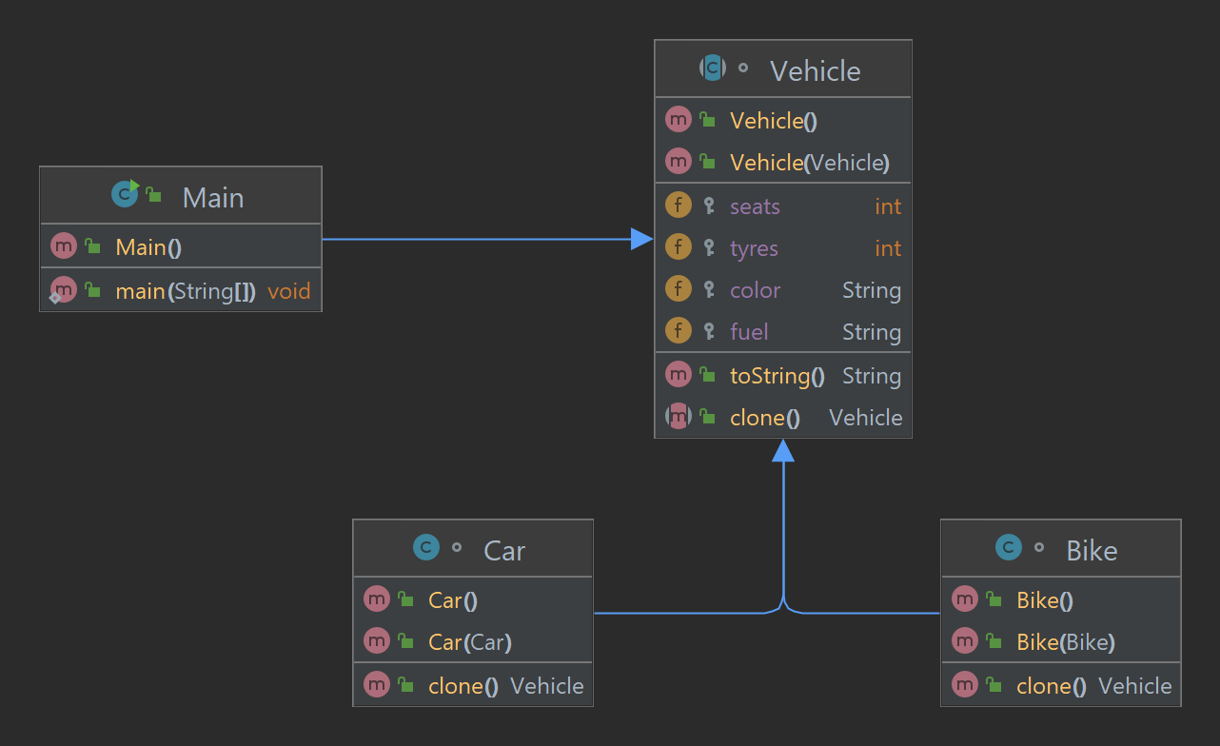
Example (UML)

Slide 15


